Slide 1
MACHINE LEARNING PROJECT
B.Tech (2nd Year)
Face recognization project

Slide 2
TABLE OF CONTENTS
01
02
03
Model creation
Experiment
What technology we are using?

Slide 3
What technology we are using in this project?

Slide 4
Technologies
NumPy: It’s a Python library which is for the mathematical computation
Pandas: It’s a Python library which is for data analysis and associated manipulation of tabular data in Data frames.
Keras: It’s a Python library which is use to create model for deep learning
You can rePplace the image on
the screen with your own
work. Just delete this one,
add yours and center it properly
Cv2: It’s an open source library which is used for image processing and performing computer vision task
Matplotlib: It’s a Python library which is used for data visualization and graphical plotting of data.

Slide 5
Model creation

Slide 6
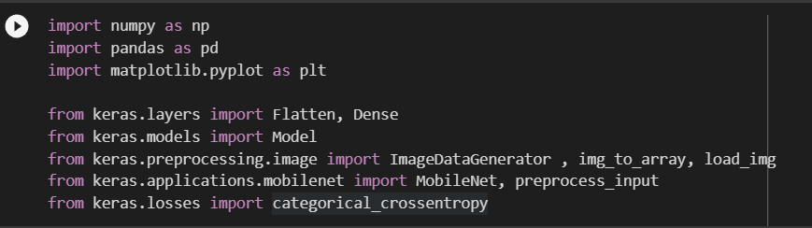
Import libraries

Slide 7
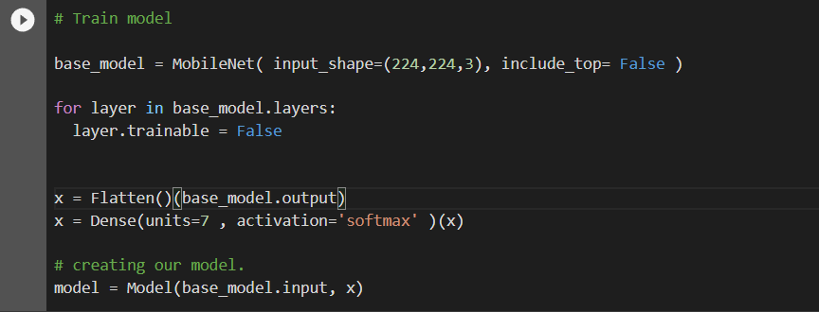
Train and create model

Slide 8
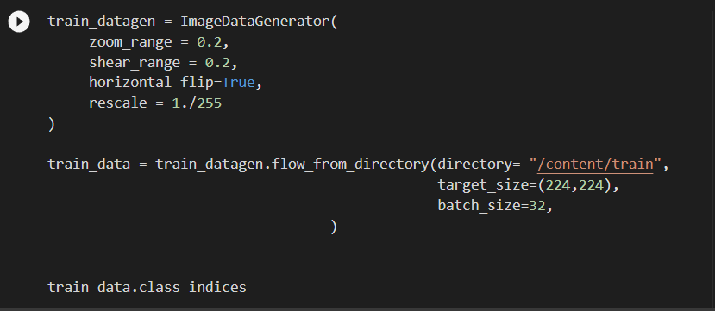
Prepare data using data generator

Slide 9
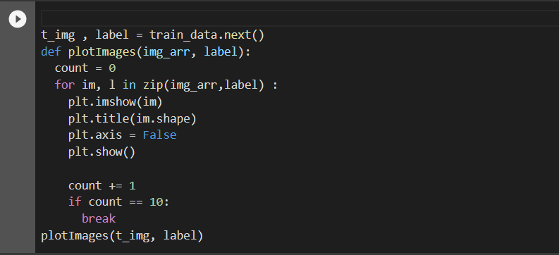
Visualize the data

Slide 10
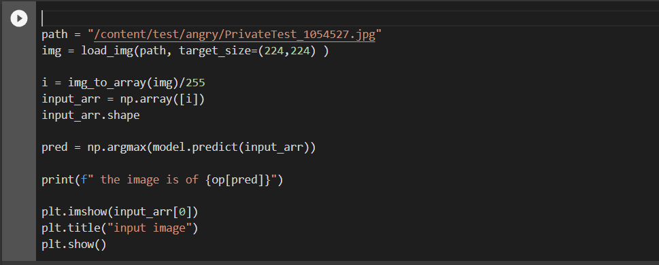
Test the data

Slide 11
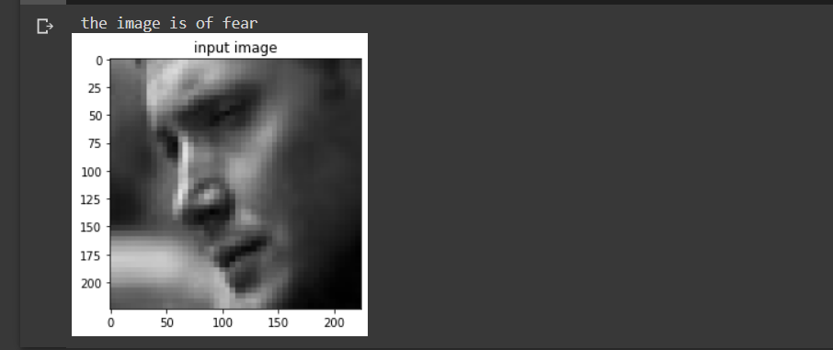
Output

Slide 12
EXPERIMENT

Slide 13
THANKS

Slide 14

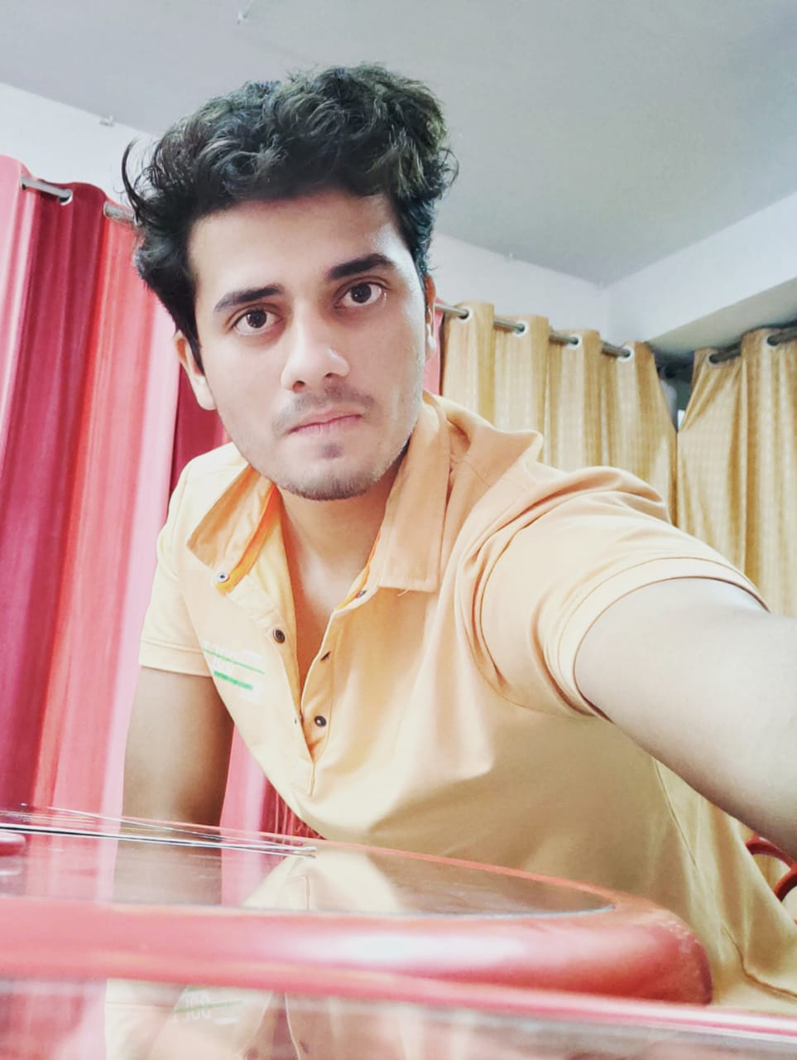

OUR TEAM
Vibhuti
Ujjawal Rachhoya
Yash Sharma
Roll. No. – 20103160
Roll. No. – 20103165
Roll. No. – 20103152

